Slide 1

University Institute of Liberal Arts and Humanities
Course Name – Communication Skills
Course Code – 23PCH-105
SUBJECT-VERB AGREEMENT
DISCOVER . LEARN . EMPOWER

Slide 2
COURSE OBJECTIVES
The Course aims to:
1 | Augment students overall communication and interpersonal skills by making them realize the importance of good oral and written English Language in professional life.
2 | Enrich their reading capability with special emphasis on expanding vocabulary and grammatical formations.
3 | Build exceptional speaking, reading and writing skills by correcting grammatical errors and pronunciation through practice.
4 | Enhances soft skills by fostering self awareness, confidence and a positive attitude in students’ ability to communicate effectively in English.

Slide 3
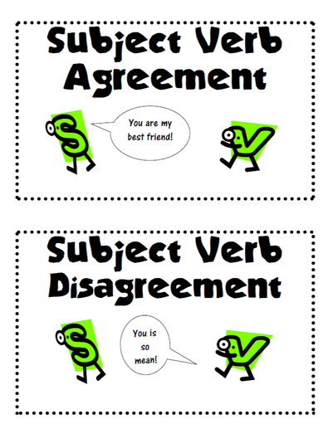
COURSE OUTCOMES
Space for visual (size 24)
On completion, the students are expected to
CO Number | Title | Level
CO1 | Apply appropriate Listening, Speaking, Reading and Writing Skills (LSRW Skills) with correct non-verbal cues to attain expertise in soft skills. | Apply
CO2 | Apply correct contextual and comprehensible written text in the form of paragraph writing, short compositions business correspondence, using logical support and argument in a wide range of communication situations. | Apply
CO3 | Demonstrate linguistic competence while speaking and during presentations through accuracy in grammatical usage, vocabulary, pronunciation and intonation. | Apply
CO4 | Evaluate information as critical readers, speakers and writers applying ethics in communication and being sensitive in cross cultural communication. | Evaluate
CO5 | Create original, digital content for websites, blogs, vlogs and personal social media profiles etc. | Create
https://www.kilmerlibrary.org

Slide 4
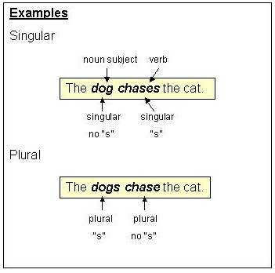
Subject Verb Agreement
Subjects and verbs must AGREE with one another in number (singular or plural).
Thus, if a subject is singular, its verb must also be singular; if a subject is plural, its verb must also be plural.
https://webapps.towson.edu/ows/moduleSVAGR.htm

Slide 5
Why Subject Verb Agreement?
Incorrect Subject Verb Agreement can cause your writing to be confusing to the reader.
Example: If your subject and verb disagree you does not sound so good.
She are a nice person. (Incorrect)

Slide 6
Rule 1
Subjects and verbs must agree in number.
Example: She writes every day.
They write every day.

Slide 7
Rule 2
Don’t get confused by the words and phrases that come between the subject and verb; they do not affect agreement.
Example: This movie, out of all other movies, is my favourite.

Slide 8
Rule 3
Two singular subjects connected by or or nor require a singular verb.
Example: A taxi or a bus is on its way.
A blue or White shirt is fine for an interview.
That guy or his friends were standing here.

Slide 9
Rule 4
When sentences start with “there” or “here”, the subject will always be placed after the verb, so care needs to be taken to identify it correctly.
Example: There are no cookies in the jar.
Here is the pen you were looking for.
There is a book in my bag.

Slide 10
Rule 5
Two singular subjects connected by either/or or neither/nor require a singular verb.
Example: Either Susan or Carol has a lecture today.
Neither Chemistry or Physics is easy to master.

Slide 11
Rule 6
If two subjects are joined by and they require a plural verb form.
Example: James and Susan look good together.

Slide 12
Rule 7
The verb is singular if the two subjects separated by and refer to the same person or thing.
Example: Red beans and rice is my mom’s favourite dish.

Slide 13
Rule 8
If one of the words each, every or no comes before the subject, the verb is singular.
Example: No smoking or drinking is allowed.
Every man and woman is required to check in.

Slide 14
Rule 9
Phrases such as together with, as well as, and along with are not the same as and. The phrase introduced by as well as or along with will modify the earlier word (mayor in this case), but it does not compound the subjects (as the word and would do).
Example: The mayor as well as his brother is going to prison.
The mayor and his brothers are going to jail.

Slide 15
Rule 10
The singular verb form is usually used for units of measurement.
Example: Four quarts of oil was required to get the car running.

Slide 16
Rule 11
When I is one of the two subjects connected by either/or or neither/nor, put it second and follow with the singular verb am.
Example: Neither she nor I am going to the festival.

Slide 17
Rule 12
Sometimes nouns seem they are plural when they are really singular and vice-versa. Words such as glasses, pants, pliers, and scissors are regarded as plural (and require plural verbs) unless they are preceded by the phrase pair of (in which case the word pair becomes the subject).
Example: My glasses were on the bed.
My pants were torn.
A pair of my jeans is in the closet.

Slide 18
Rule 13
If one subject is singular and one plural and the words are connected by the words or, nor, neither/nor, either/or, and not only/but also, you use the verb form of the subject that is nearest the verb.
Example: Either the bears or the lion has escaped from the zoo.
Neither the lion nor the bears have escaped from the zoo.

Slide 19
Rule 14
Use a singular verb with sums of money or periods of time.
Example: Ten dollars is a high price to pay.
Five years is the maximum sentence for that offense.

Slide 20
Rule 15
Collective nouns like herd, senate, class, crowd, etc. usually take a singular verb form.
Example: The herd is stampeding.
The Senate has taken a unanimous decision.

Slide 21
Rule 16
The indefinite pronouns anyone, everyone, someone, no one, nobody, are always singular and, therefore, require singular verbs. Everyone and everybody certainly feel like more than one person and, therefore, students are sometimes tempted to use a plural verb with them. Each is often followed by a prepositional phrase ending in a plural word (Each of the cars), thus confusing the verb choice. Each, too, is always singular and requires a singular verb.
Example: Everyone has done his or her homework.
Somebody has left her purse.

Slide 22
Rule 17
Some words end in -s and appear to be plural but are really singular and require singular verbs.
Example: The news from the front is bad.
Measles is a dangerous disease for pregnant women.

Slide 23
Rule 18
Fractional expressions such as half of, a part of, a percentage of, a majority of are sometimes singular and sometimes plural, depending on the meaning. Sums and products of mathematical processes are expressed as singular and require singular verbs. The expression “more than one” takes a singular verb: “More than one student has tried this.” Example:
Some of the voters are still angry.
A large percentage of the older population is voting against her.
Two-fifths of the troops were lost in the battle.

Slide 24
Rule 19
If a sentence compounds a positive and a negative subject and one is plural, the other singular, the verb should agree with positive subject.
Example: It is not the faculty members but the president who decided this issue.
It was the speaker, not his ideas, that has provoked the students to riot.

Slide 25
Exercise
A bouquet of yellow roses lend/lends color and fragrance to the room.
Annie and her brothers (is, are) at school.
George and Tamara (doesn't, don't) want to see that movie.
One of my sisters (is, are) going on a trip to France.
The movie, including all the previews, (take, takes) about two hours to watch.
Either answer (is, are) acceptable.

Slide 26
Answers
Lends
Are
Don’t
Is
Takes
Is

Slide 27
References
https://academicguides.waldenu.edu/writingcenter/grammar/subjectverbagreement
http://guidetogrammar.org/grammar/sv_agr.htm
https://examples.yourdictionary.com/examples-of-subject-verb-agreement.html
https://grammar.yourdictionary.com/sentences/20-rules-of-subject-verb-agreement.html
https://www.grammarbook.com/grammar/subjectVerbAgree.asp
Chandigarh University Study Material for Communication Skills

Slide 28
Application
Using the correct grammar (when one writes or speaks) is important to avoid misunderstandings, and to help the other person understand easily. If ones English is too full of mistakes, it will slow down communication and conversations. It will be harder to express ones ideas and thoughts clearly and concisely.
Understanding Subject verb Agreement will help students to know the syntactical relation that exists between a subject and a verb in a sentence and to avoid ambiguities.

Slide 29
Assessment Pattern
Students are assessed on the basis of the following parameters:
Hourly Tests-2
Assignments
Surprise Test
Quiz
Students Engagement
End Semester Exam

Slide 30
THANK YOU
For queries
Email: communicationskills.uilah@gmail.com

